Slide 1
Oxford University: Said Business School Integrated Reporting for a Sustainable Strategy May 24, 2010
Robert G. Eccles

Slide 2
The Importance of Corporate Reporting
Influences decisions and actions of management
An essential element of corporate governance
Influences decisions and actions of shareholders and other stakeholders
Affects resource allocation (financial, natural and human resources) in society
Critical for investor confidence

Slide 3
What Is Integrated Reporting?
An embryonic new management practice
A simple idea whose time has come
A single document reporting the company’s financial, environmental, social and governance performance
Explanations of relationships between financial and nonfinancial (ESG) performance
Reporting of more detailed information of interest to specific stakeholders
Leveraging the Internet to improve dialogue and engagement with all stakeholders
A way of reframing the corporate reporting debate
A powerful mechanism for changing resource allocation decisions

Slide 4
The State of Integrated Reporting Today
Its meaning is not well-defined
It involves both documents and websites
Only a few companies are doing it
Different countries
Different industries
A simple but powerful idea whose time has come
Degree of integration varies
Little information on the relationship between financial and nonfinancial performance is provided
No generally accepted frameworks exist
An aspiration and a direction
Greater clarity will come from experimentation

Slide 5
20 Years of Research on Corporate Reporting
“The Performance Measurement Manifesto,” Harvard Business Review, 69, no. 1, January-February 1991: 131-137
Eccles, Robert G., and Sarah Clay Mavrinac, “Improving the Corporate Disclosure Process,” MIT Sloan Management Review, 36, no. 4, Summer 1995: 11-25.
Eccles, Robert G., Robert H. Herz, E. Mary Keegan, and David M.H. Phillips, The ValueReporting Revolution: Moving Beyond the Earnings Game, New York: John Wiley & Sons, Inc., 2001.
Eccles, Robert G., and Samuel A. DiPiazza, Jr., Building Public Trust: The Future of Corporate Reporting, New York: John Wiley & Sons, Inc., 2002.
Eccles, Robert G., and Michael P. Krzus, One Report: Integrated Reporting for a Sustainable Strategy, New York: John Wiley & Sons, Inc., 2010.

Slide 6
Data Collection and Analysis
Interviewed 197 people (Jan-Sep 2009)
Conducted 224 interview sessions
Plus, extensive review of documents and websites of 35 companies
(15 doing integrated reporting)

Slide 7
AEP Press Release
AEP Charts Financial, Environmental and Social Performance in First Integrated Corporate Accountability Report
COLUMBUS, Ohio, April 28 /PRNewswire-FirstCall/ -- American Electric Power (NYSE: AEP) has released its first Corporate Accountability Report, presenting information about the company's financial, environmental and social performance together for the first time. The report and other supporting data and materials are available on AEP's new sustainability website, http://www.aepsustainability.com/.
"We are proud to be one of the first companies in the nation to develop an integrated report that recognizes the strong connection between our financial performance and our environmental and social responsibilities," said Michael G. Morris, AEP's chairman, president and chief executive officer. "Our decision to combine our annual report to shareholders with our corporate sustainability report reflects our commitment to hold ourselves accountable for our actions and results, and it demonstrates our efforts to be transparent and to consider the environmental and social impact of everything we do."

Slide 8
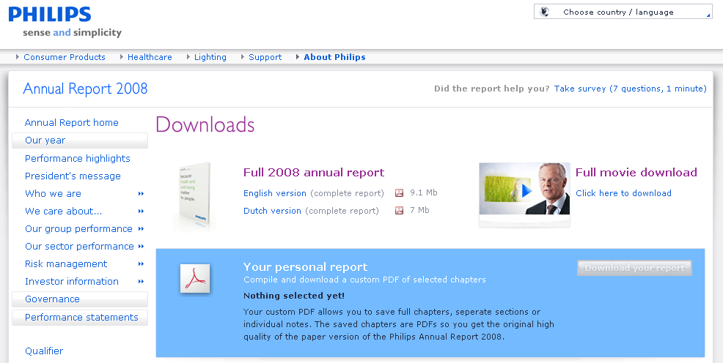
Philips’ First Integrated Report
The second page of Philips’ 276-page Annual Report 2008: Financial, social and environmental performance explained why the company decided to combine all of this information into a single report:
“Simplifying our external annual reporting in order to better meet the needs
of stakeholders, this year’s Annual Report covers both our financial and our
social and environmental performance in a single volume. This reflects the
act that sustainability is no mere adjunct to, but rather embedded in the
very fabric of our business operations. Our Annual Report 2008 will also be the last to be based on both US GAAP (Generally Accepted Accounting Principles in the United States) and IFRS (International Financial Reporting Standards): as of 2009 we will apply IFRS only.”
http://www.annualreport2008.philips.com/downloads/index.asp

Slide 9
External Reporting Challenges
Financial
Nonfinancial
Complexity
Meaningful narrative information
Reporting on risk, executive compensation and corporate governance
Auditing for fraud
Lack of standards
Lack of common terminology
Definition of “materiality”
Underdeveloped audit methodologies
Controversial role of the Global Reporting Initiative
Competing standard setters

Slide 10
“Standard-Setters” for Nonfinancial Information

Slide 11
Increasing Use of the Term Corporate Social Responsibility, 1989-2008 (Factiva)
Notes:
For all of our “Increasing Use of the Term…” figures, we used the Dow Jones Factiva database to do a yearly word count for the use of the term in all publications included in the database.

Slide 12
Increasing Use of the Term Sustainability, 1989-2008 (Factiva)
Notes:
For all of our “Increasing Use of the Term…” figures, we used the Dow Jones Factiva database to do a yearly word count for the use of the term in all publications included in the database.

Slide 13
Growth in Number of CSR Reports
Source: www.CorporateRegister.com

Slide 14
CSR Reports with Formal Assurance Statement
Country | 2002 (%) | 2005 (%) | 2008 (%)
France | 14 | 40 | 73
Spain | 27 | 44 | 70
Italy | 66 | 70 | 61
UK | 53 | 53 | 55
Denmark | 45 | 31 | 46
Netherlands | 38 | 40 | 44
Australia | 42 | 43 | 42
South Africa | 100* | 22 | 36
Sweden | 15 | 5 | 33
Finland | 29 | 19 | 30
Norway | 20 | 33 | 30
Japan | 26 | 31 | 24
Canada | 10 | 10 | 19
USA | 2 | 3 | 14
* One report issued. Source: KPMG. International Survey of Corporate Responsibility Reporting 2008, p. 56-58

Slide 15
Few Companies are Doing Integrated Reporting
%
Limited integration—CR section in the annual report
Source: KPMG International Survey of Corporate Responsibility Reporting 2008, p. 17. G250 refers to the largest 250 companies in the world from Fortune magazine’s Global 500 list for 2007 and N100 refers to the top 100 companies by revenues in each of 22 countries.
Notes:
Limited integration—CSR section in the annual report
49% of the G250
33% of the N100
CSR reporting combined with their annual report
8% of the G250
9% of the N100
3% of both groups had a fully integrated report

Slide 16
Industries of Companies Doing Integrated Reporting
Logistics
Electric utility
Telecommunications
Pharmaceuticals
Eucalyptus pulp production
Insurance services
Cosmetics
Financial services
Healthcare, Consumer and Lighting
Waste renewal and recycling
Mining
Bioinnovation
Manufacturing
Chemicals

Slide 17
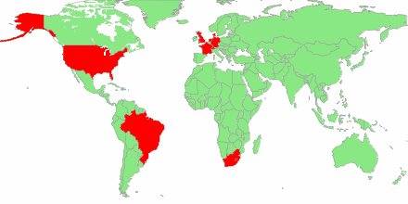
Locations of Companies Doing Integrated Reporting
Denmark Netherlands
Novo Nordisk, Novozymes Philips, Rabobank
France TNT, Van Gansewinkel Groep
Alstom Switzerland
Germany Novartis
BASF U.K.
Aviva, BT, HSBC
U.S.
American Electric Power
United Technologies
South Africa
Anglo Platinum
Brazil
Aracruz (now Fibria)
Natura

Slide 18
Timeline for Adoption of Integrated Reporting
Year | First integrated report
2002 | Novozymes
2003 | Natura
2004 | Novo Nordisk
2005
2006 | Aracruz (now Fibria)
2007 | BASF
2008 | Alstom Aviva BT HSBC Novartis Philips United Technologies Van Gansewinkel Groep
2009 | American Electric Power Anglo Platinum Rabobank TNT Logistics

Slide 19
Market Cap and Revenues for One Report Companies
Company | Market cap ($m)¹ | Revenue ($m)²
HSBC | 176,060 | 42,043
Novartis | 115,292 | 47,165
United Technologies | 69,347 | 52,901
BASF | 55,942 | 72,673
Novo Nordisk | 54,619 | 9,838
Philips | 31,272 | 33,244
Anglo Platinum | 26,077 | 4,971
Alstom | 17,244 | 24,848
American Electric Power | 15,953 | 13,489
BT | 14,815 | 33,918
Aviva | 14,671 | 78,517
TNT Logistics | 11,349 | 14,912
Aracruz (now Fibria) | 9,358 | 3,438
Natura | 8,785 | 2,432
Novozymes | 6,716 | 1,627
Rabobank | N/A | 17,013
Van Gansewinkel Groep | N/A | 1,630
¹ Market cap as of 4/27-4/28/10; ² Revenues as of 12/31/09 except Alstom (3/31/09).

Slide 20
Audits of Integrated Reports
Company | Auditor | Audit report on nonfinancial information
American Electric Power | Deloitte & Touche | No
Alstom | Deloitte and Ernst & Young | No
Anglo Platinum | Deloitte & Touche | PricewaterhouseCoopers
Aracruz (now Fibria) | Bureau Veritas | Yes, in one report
Aviva | E&Y | Separate report by CSR boutique
BASF | KPMG | Yes, in one report
BT | PricewaterhouseCoopers | No
HSBC | KPMG | No
Natura | Deloitte Touche Tohmatsu | Separate report by CSR boutique
Novartis | PricewaterhouseCoopers | No
Novo Nordisk | PricewaterhouseCoopers | Yes, in one report
Novozymes | PricewaterhouseCoopers | Yes, in one report
Philips | KPMG | Yes, separate report
Rabobank | Ernst & Young | KPMG
TNT Logistics | PricewaterhouseCoopers | Yes, separate report
United Technologies | PricewaterhouseCoopers | No
Van Gansewinkel Groep | PricewaterhouseCoopers | No

Slide 21
Corporate Social Responsibility and Sustainability
Corporate social responsibility
Sustainable Strategy
for a Sustainable Society
Value to shareholders
Sustainable development
Sustainable competitive advantage
Sustainable strategy
Value to society
A sustainable society requires that all companies have sustainable strategies
Sustainable strategies require integrated reporting

Slide 22
BASF’s Energy Verbund
Energy Verbund* Efficient use of resources
Value for BASF up to 1.5 million metric tons of oil equivalent saved per year | Value for the environment 3.4 million metric tons reduction in CO₂
Value for BASF In BASF’s Energy Verbund, production and energy needs are intelligently linked so that heat from production processes can be used as energy in other operations, thus saving both primary resources and costs. Value for the environment With the Energy Verbund, BASF reduces the use of fossil fuels and thereby also lowers CO2 emissions.
*In the BASF Verbund, production facilities, energy flow, logistics and infrastructure are intelligently networked with each other, in order to increase production yields, save resources and energy and reduce logistic costs. A significant factor in the Verbund concept is the Know-how Verbund. In the latter, know-how is shared among BASF employees worldwide and expert knowledge is pooled in research platforms.

Slide 23
BASF’s New HPPO Technology
New HPPO* technology from BASF and Dow Greater energy efficiency, less wastewater
Value for BASF requires up to 25% less capital to build new plants in comparison to traditional technologies | Value for the environment up to 40 metric tons less wastewater per ton of sales product compared to conventional processes
Plants using the HPPO technology jointly developed by BASF and DOW to produce propylene oxide are significantly more economical than those using existing processes. The use of the new technology not only reduces wastewater, it also lowers energy consumption by up to 35%.
*Technology to produce propylene oxide (PO) from hydrogen peroxide (HP). HPPO technology is more environmentally friendly and economically viable than conventional PO methods of production, because no by-products are produced besides water. PO is an intermediate, for example, in the production of polyurethane.

Slide 24
BASF Using Web 2.0
BASF TV commercial music as your ringtone
RSS feeds
Chart Generator
Audio version
Social bookmarking
Videos through BASF TV service
Online version allows users to create their own report

Slide 25
Sustainable Strategies for a Sustainable Society
New Business Model: Sustainable development for society requires a new business model for companies.
Long-Term View: This model requires a long-term view by the company and, by implication, its shareholders, who are one class of stakeholder.
Multiple Stakeholder Perspective: It also requires the recognition of the legitimacy of the interests of other stakeholders, who must also take a long-term view.
Engagement Processes: This new model depends upon processes of engagement for understanding the expectations of all stakeholders.
Value Creation for All Stakeholders: Doing so contributes to value creation for shareholders as well as to meeting the needs of other stakeholders.
Risk of Not Adopting the New Model: Failure to adopt this new model will put at risk the company’s reputation and its ability to create shareholder value and can even imperil its existence.
Benefit of Adopting the New Model: Implementing it well can be a real source of competitive advantage.

Slide 26
Reasons Why Companies Are Practicing Integrated Reporting
To signal that the company is taking sustainability seriously
To signal that a commitment to sustainability is good for shareholders
To improve reporting transparency
To position the company as a leader and innovator
To help integrate sustainability into strategy and operations
To simplify external reporting

Slide 27
Challenges in Doing Integrated Reporting
“Closing the nonfinancial books” on time
Interfunctional coordination
Deciding on appropriate level of detail
Lack of agreed-upon standards and audit (vs. assurance) methodologies
Poor understanding of the relationship between financial and nonfinancial performance
Getting the attention of investors for nonfinancial information
Getting the attention of other stakeholders for financial information

Slide 28
Objections to Integrated Reporting
Assertion
Response
The markets are efficient
Companies are already optimally managed
The development of a sustainable society will be hindered
It will cost money
Active money managers assume otherwise
Change would never happen
Trade-offs must be understood and made
The company will be better managed

Slide 29
Speeding the Adoption of Integrated Reporting
Companies must take responsibility to act
Innovation by many constituencies is necessary
Support from the investment community is vital
Development of standards is essential
Legislation and regulation will ultimately be required
Support from civil society will encourage others to act

Slide 30
International Integrated Reporting Committee
As you know, following the meeting at St James’s Palace in September last year, on 17th December His Royal Highness highlighted the need to establish an ‘International Integrated Reporting Committee’ (IIRC) to create an international integrated reporting framework. The proposals received universal support and as a result a Steering Committee and Working Group are being set up to establish the IIRC.
The Prince of Wales would be delighted if you were able to support the IIRC initiative by participating as a member of the Steering Committee mentioned above. I attach a list of those who have already confirmed their participation (Attachment A), together with a copy of the draft terms of reference (Attachment B). Invitations are currently being extended to additional organisations to ensure that both the Steering Committee and Working Group reflect an appropriate balance of representation.
As you are well aware, the way we live and the way we consume resources need to change if current levels of prosperity are to be maintained in the developed world and increased significantly in developing countries. A shift to an integrated reporting model that reflects the interconnected nature of environmental, social, governance and financial factors, is an essential step towards the creation of a sustainable economy, and I very much hope that you be able to help us with this ambition.
Letter from HRH The Prince of Wales, Accounting for Sustainability Project, April 1, 2010

Slide 31
Action Items
Book (One Report: Integrated Reporting for a Sustainable Strategy, with Michael P. Krzus) published March 2010 (translations in Chinese, Japanese, and Portuguese)
Social movement website (www.integratedreporting.org) created
Member of the Steering Committee of the International Integrated Reporting Committee
Presentation on integrated reporting to the Investor as Shareholder Subcommittee of the SEC’s Investor Advisory Committee, May 18
Create more awareness at Global Reporting Initiative bi-annual conference
Recommendation for the SEC and other securities regulators to establish a “voluntary filing program” for integrated reporting
Conference on “Developing an Action Plan for Integrated Reporting” at HBS on October 14-15 as part of the Business and Environment Initiative
Prince of Wales Accounting for Sustainability Project Annual Forum in December 2010
Get integrated reporting on the agenda of the G20 meeting being hosted by France in early 2011

Slide 32
Thank You!

